Slide 1
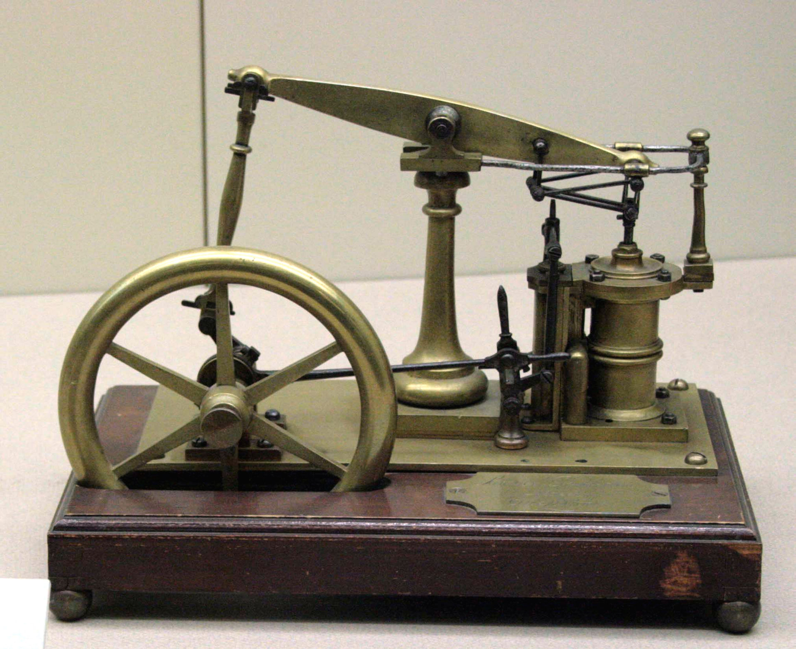
Classifier
Feature vector X:
[1, 4.5, 5, 2, 2.6]
Output label Y
[0]
Public domain image by Tamorlan https://tinyurl.com/y7wgavet
Generative model
Class label Y
[0]
Feature vector X:
[1, 4.5, 5, 2, 2.6]

